Slide 1
Chapter 22 – Project Management
CS 425 November 12, 2024
Ian Sommerville,
Software Engineering, 10th Edition
Pearson Education, Addison-Wesley
Note: These are a slightly modified version of Chapter 22 slides available from the author’s site http://iansommerville.com/software-engineering-book/
Chapter 22 Project management

Slide 2
Topics covered
What is software project management?
Risk management
Managing people
Teamwork
Chapter 22 Project management

Slide 3
Software project management
Concerned with activities involved in ensuring that software is delivered on time and on schedule and in accordance with the requirements of the organizations developing and procuring the software
Project management is needed because software development is always subject to budget and schedule constraints that are set by the organization developing the software
Chapter 22 Project management

Slide 4
Success criteria
Deliver the software to the customer at the agreed time
Keep overall costs within budget
Deliver software that meets the customer’s expectations
Maintain a coherent and well-functioning development team
Chapter 22 Project management

Slide 5
Software management distinctions
The product is intangible
Software cannot be seen or touched. Software project managers cannot see progress by simply looking at the artefact that is being constructed.
Many software projects are 'one-off' projects
Large software projects are usually different in some ways from previous projects. Even managers who have lots of previous experience may find it difficult to anticipate problems.
Software processes are variable and organization specific
We still cannot reliably predict when a particular software process is likely to lead to development problems
Chapter 22 Project management

Slide 6
Factors influencing project management
Company size
Software customers
Software size
Software type
Organizational culture
Software development processes
These factors mean that project managers in different organizations may work in quite different ways
Chapter 22 Project management

Slide 7
Universal management activities
Project planning
Project managers are responsible for planning, estimating and scheduling project development and assigning people to tasks
Covered in Chapter 23
Risk management
Project managers assess the risks that may affect a project, monitor these risks and take action when problems arise
People management
Project managers have to choose people for their team and establish ways of working that leads to effective team performance
Chapter 22 Project management

Slide 8
Management activities
Reporting
Project managers are usually responsible for reporting on the progress of a project to customers and to the managers of the company developing the software
Proposal writing
The first stage in a software project may involve writing a proposal to win a contract to carry out an item of work. The proposal describes the objectives of the project and how it will be carried out
Chapter 22 Project management

Slide 9
Project Triangle
04/12/2014
Chapter 22 Project management

Slide 10
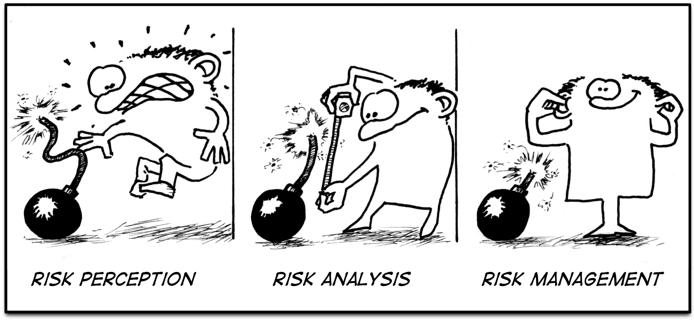
Risk management
Chapter 22 Project management

Slide 11
Risk management
Risk management is concerned with identifying risks and drawing up plans to minimise their effect on a project
Software risk management is important because of the inherent uncertainties in software development
These uncertainties stem from loosely defined requirements, requirements changes due to changes in customer needs, difficulties in estimating the time and resources required for software development, and differences in individual skills
You have to anticipate risks, understand the impact of these risks on the project, the product and the business, and take steps to avoid these risks
Chapter 22 Project management

Slide 12
Risk classification
There are two dimensions of risk classification
The type of risk (technical, organizational, etc.)
What is affected by the risk
Project risks affect schedule or resources
Product risks affect the quality or performance of the software being developed
Business risks affect the organization developing or procuring the software
Chapter 22 Project management

Slide 13
Examples of project, product, and business risks
Risk | Affects | Description
Staff turnover | Project | Experienced staff will leave the project before it is finished.
Management change | Project | There will be a change of organizational management with different priorities.
Hardware unavailability | Project | Hardware that is essential for the project will not be delivered on schedule.
Requirements change | Project and product | There will be a larger number of changes to the requirements than anticipated.
Specification delays | Project and product | Specifications of essential interfaces are not available on schedule.
Size underestimate | Project and product | The size of the system has been underestimated.
CASE tool underperformance | Product | CASE tools, which support the project, do not perform as anticipated.
Technology change | Business | The underlying technology on which the system is built is superseded by new technology.
Product competition | Business | A competitive product is marketed before the system is completed.
Chapter 22 Project management

Slide 14
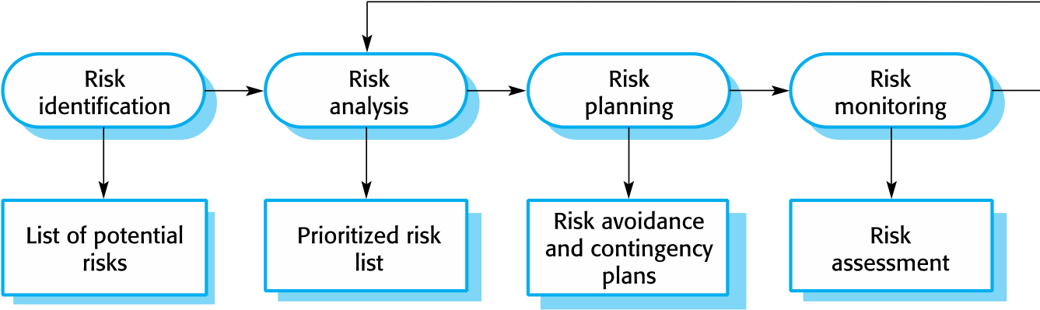
The risk management process
Chapter 22 Project management
Notes:
Risk identification
Identify project, product and business risks
Risk analysis
Assess the likelihood and consequences of these risks
Risk planning
Draw up plans to avoid or minimise the effects of the risk
Risk monitoring
Monitor the risks throughout the project

Slide 15
Risk identification
May be a team activities or based on the individual project manager’s experience
A checklist of common risks may be used to identify risks in a project
Technology risks
Organizational risks
People risks
Requirements risks
Estimation risks
Chapter 22 Project management

Slide 16
Examples of different risk types
Risk type | Possible risks
Estimation | The time required to develop the software is underestimated. (12) The rate of defect repair is underestimated. (13) The size of the software is underestimated. (14)
Organizational | The organization is restructured so that different management are responsible for the project. (6) Organizational financial problems force reductions in the project budget. (7)
People | It is impossible to recruit staff with the skills required. (3) Key staff are ill and unavailable at critical times. (4) Required training for staff is not available. (5)
Requirements | Changes to requirements that require major design rework are proposed. (10) Customers fail to understand the impact of requirements changes. (11)
Technology | The database used in the system cannot process as many transactions per second as expected. (1) Reusable software components contain defects that mean they cannot be reused as planned. (2)
Tools | The code generated by software code generation tools is inefficient. (8) Software tools cannot work together in an integrated way. (9)
Chapter 22 Project management

Slide 17
Risk analysis
Assess probability and seriousness of each risk
Probability may be very low, low, moderate, high or very high
Risk consequences might be catastrophic, serious, tolerable or insignificant
Chapter 22 Project management

Slide 18
Risk types and examples
Risk | Probability | Effects
Organizational financial problems force reductions in the project budget (7). | Low | Catastrophic
It is impossible to recruit staff with the skills required for the project (3). | High | Catastrophic
Key staff are ill at critical times in the project (4). | Moderate | Serious
Faults in reusable software components have to be repaired before these components are reused. (2). | Moderate | Serious
Changes to requirements that require major design rework are proposed (10). | Moderate | Serious
The organization is restructured so that different management are responsible for the project (6). | High | Serious
The database used in the system cannot process as many transactions per second as expected (1). | Moderate | Serious
Chapter 22 Project management

Slide 19
Risk types and examples
Risk | Probability | Effects
The time required to develop the software is underestimated (12). | High | Serious
Software tools cannot be integrated (9). | High | Tolerable
Customers fail to understand the impact of requirements changes (11). | Moderate | Tolerable
Required training for staff is not available (5). | Moderate | Tolerable
The rate of defect repair is underestimated (13). | Moderate | Tolerable
The size of the software is underestimated (14). | High | Tolerable
Code generated by code generation tools is inefficient (8). | Moderate | Insignificant
Chapter 22 Project management

Slide 20
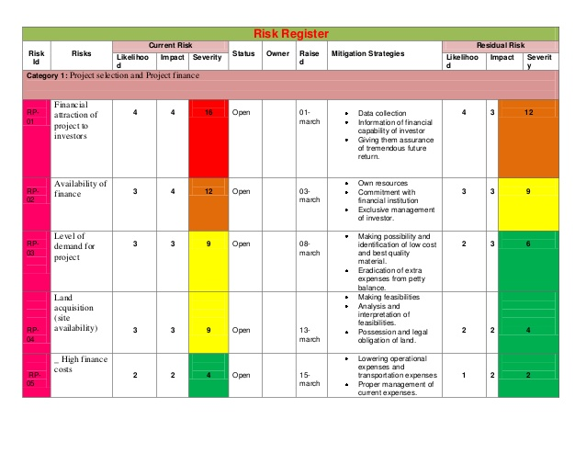
04/12/2014
Chapter 22 Project management

Slide 21
Risk planning
Consider each risk and develop a strategy to manage that risk
Avoidance strategies
The probability that the risk will arise is reduced
Minimization strategies
The impact of the risk on the project or product will be reduced
Contingency plans
If the risk arises, contingency plans are plans to deal with that risk
Chapter 22 Project management

Slide 22
What-if questions
What if several engineers are ill at the same time?
What if an economic downturn leads to budget cuts of 20% for the project?
What if the performance of open-source software is inadequate and the only expert on that open source software leaves?
What if the company that supplies and maintains software components goes out of business?
What if the customer fails to deliver the revised requirements as predicted?
Chapter 22 Project management

Slide 23
Strategies to help manage risk
Risk | Strategy
Organizational financial problems | Prepare a briefing document for senior management showing how the project is making a very important contribution to the goals of the business and presenting reasons why cuts to the project budget would not be cost-effective.
Recruitment problems | Alert customer to potential difficulties and the possibility of delays; investigate buying-in components.
Staff illness | Reorganize team so that there is more overlap of work and people therefore understand each other’s jobs.
Defective components | Replace potentially defective components with bought-in components of known reliability.
Requirements changes | Derive traceability information to assess requirements change impact; maximize information hiding in the design.
Chapter 22 Project management

Slide 24
Strategies to help manage risk
Risk | Strategy
Organizational restructuring | Prepare a briefing document for senior management showing how the project is making a very important contribution to the goals of the business.
Database performance | Investigate the possibility of buying a higher-performance database.
Underestimated development time | Investigate buying-in components; investigate use of a program generator.
Chapter 22 Project management

Slide 25
Risk monitoring
Assess each identified risks regularly to decide whether or not it is becoming less or more probable
Also assess whether the effects of the risk have changed
Each key risk should be discussed at management progress meetings
Chapter 22 Project management

Slide 26
Risk indicators
Risk type | Potential indicators
Estimation | Failure to meet agreed schedule; failure to clear reported defects.
Organizational | Organizational gossip; lack of action by senior management.
People | Poor staff morale; poor relationships amongst team members; high staff turnover.
Requirements | Many requirements change requests; customer complaints.
Technology | Late delivery of hardware or support software; many reported technology problems.
Tools | Reluctance by team members to use tools; complaints about CASE tools; demands for higher-powered workstations.
Chapter 22 Project management

Slide 27
04/12/2014
Chapter 22 Project management

Slide 28
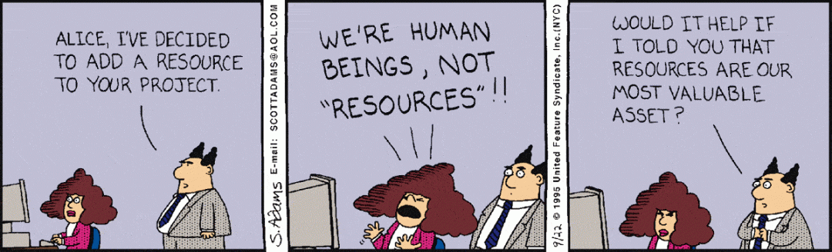
Managing people
Chapter 22 Project management

Slide 29
Managing people
People are an organization’s most important assets
The tasks of a manager are essentially people-oriented. Unless there is some understanding of people, management will be unsuccessful.
Poor people management is an important contributor to project failure
Chapter 22 Project management

Slide 30
People management factors
Consistency
Team members should all be treated in a comparable way without favourites or discrimination
Respect
Different team members have different skills and these differences should be respected
Inclusion
Involve all team members and make sure that people’s views are considered
Honesty
You should always be honest about what is going well and what is going badly in a project
Chapter 22 Project management

Slide 31
Motivating people
An important role of a manager is to motivate the people working on a project
Motivation means organizing the work and the working environment to encourage people to work effectively
If people are not motivated, they will not be interested in the work they are doing. They will work slowly, be more likely to make mistakes and will not contribute to the broader goals of the team or the organization.
Motivation is a complex issue but it appears that their are different types of motivation based on:
Basic needs (e.g. food, sleep, etc.);
Personal needs (e.g. respect, self-esteem);
Social needs (e.g. to be accepted as part of a group).
Chapter 22 Project management

Slide 32
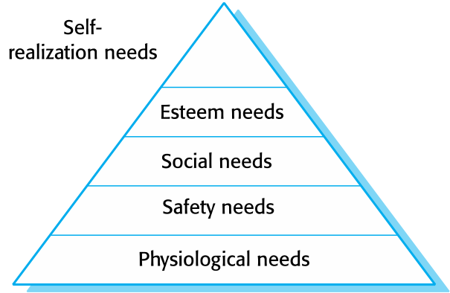
Need satisfaction
In software development groups, basic physiological and safety needs are not an issue.
Social
Provide communal facilities
Allow informal communications, e.g. via social networking
Esteem
Recognition of achievements
Appropriate rewards
Self-realization
Training - people want to learn more
Responsibility
Chapter 22 Project management

Slide 33
Personality types
The needs hierarchy is almost certainly an over-simplification of motivation in practice
Motivation should also take into account different personality types:
Task-oriented people, who are motivated by the work they do in software engineering
Interaction-oriented people, who are motivated by the presence and actions of co-workers
Self-oriented people, who are principally motivated by personal success and recognition
Chapter 22 Project management

Slide 34
Personality types
Task-oriented
The motivation for doing the work is the work itself
Self-oriented
The work is a means to an end which is the achievement of individual goals - e.g. to get rich, play tennis, travel, etc.
Interaction-oriented
The principal motivation is the presence and actions of co-workers. People go to work because they like to go to work.
Chapter 22 Project management

Slide 35
Motivation balance
Individual motivations are made up of elements of each class
The balance can change depending on personal circumstances and external events
However, people are not just motivated by personal factors but also by being part of a group and culture
People go to work because they are motivated by the people that they work with
Chapter 22 Project management

Slide 36

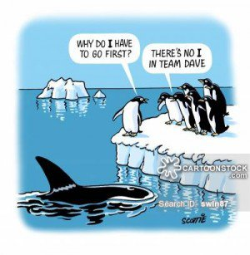
Teamwork
Chapter 22 Project management

Slide 37
Teamwork
Most software engineering is a group activity
The development schedule for most non-trivial software projects is such that they cannot be completed by one person working alone
A good group is cohesive and has a team spirit. The people involved are motivated by the success of the group as well as by their own personal goals.
Group interaction is a key determinant of group performance
Flexibility in group composition is limited
Managers must do the best they can with available people
Chapter 22 Project management

Slide 38
Group cohesiveness
In a cohesive group, members consider the group to be more important than any individual in it
The advantages of a cohesive group are:
Group quality standards can be developed by the group members
Team members learn from each other and get to know each other’s work; Inhibitions caused by ignorance are reduced
Knowledge is shared. Continuity can be maintained if a group member leaves.
Refactoring and continual improvement is encouraged. Group members work collectively to deliver high quality results and fix problems, irrespective of the individuals who originally created the design or program.
Chapter 22 Project management

Slide 39
Team spirit
Alice, an experienced project manager, understands the importance of creating a cohesive group. As they are developing a new product, she takes the opportunity of involving all group members in the product specification and design by getting them to discuss possible technology with elderly members of their families. She also encourages them to bring these family members to meet other members of the development group.
Alice also arranges monthly lunches for everyone in the group. These lunches are an opportunity for all team members to meet informally, talk around issues of concern, and get to know each other. At the lunch, Alice tells the group what she knows about organizational news, policies, strategies, and so forth. Each team member then briefly summarizes what they have been doing and the group discusses a general topic, such as new product ideas from elderly relatives.
Every few months, Alice organizes an ‘away day’ for the group where the team spends two days on ‘technology updating’. Each team member prepares an update on a relevant technology and presents it to the group. This is an off-site meeting in a good hotel and plenty of time is scheduled for discussion and social interaction.
Chapter 22 Project management
Notes:
What are some things Alice does to help create a cohesive group dynamic?
One of the most effective ways of promoting cohesion is to be inclusive.
Alice arranges regular informal meetings where she tells the other group members what is going on
She makes a point of involving people in the product deflowerment by asking them to come up with a new ideas derived from their own family experiences
The “away days” are also good ways of prompting cohesion. People relax together while they help each outehr lean about new technologies

Slide 40
The effectiveness of a team
The people in the group
You need a mix of people in a project group as software development involves diverse activities such as negotiating with clients, programming, testing and documentation
The group organization
A group should be organized so that individuals can contribute to the best of their abilities and tasks can be completed as expected
Technical and managerial communications
Good communications between group members, and between the software engineering team and other project stakeholders, is essential
Chapter 22 Project management

Slide 41
Selecting group members
A manager or team leader’s job is to create a cohesive group and organize their group so that they can work together effectively
This involves creating a group with the right balance of technical skills and personalities, and organizing that group so that the members work together effectively
Chapter 22 Project management

Slide 42
Assembling a team
May not be possible to appoint the ideal people to work on a project
Project budget may not allow for the use of highly-paid staff
Staff with the appropriate experience may not be available
An organization may wish to develop employee skills on a software project
Managers have to work within these constraints especially when there are shortages of trained staff
Chapter 22 Project management

Slide 43
Group composition
Group composed of members who share the same motivation can be problematic
Task-oriented - everyone wants to do their own thing;
Self-oriented - everyone wants to be the boss;
Interaction-oriented - too much chatting, not enough work.
An effective group has a balance of all types
This can be difficult to achieve software engineers are often task-oriented
Interaction-oriented people are very important as they can detect and defuse tensions that arise
Chapter 22 Project management

Slide 44
Group composition
In creating a group for assistive technology development, Alice is aware of the importance of selecting members with complementary personalities. When interviewing potential group members, she tried to assess whether they were task-oriented, self-oriented, or interaction-oriented. She felt that she was primarily a self-oriented type because she considered the project to be a way of getting noticed by senior management and possibly promoted. She therefore looked for one or perhaps two interaction-oriented personalities, with task-oriented individuals to complete the team. The final assessment that she arrived at was:
Alice—self-oriented
Brian—task-oriented
Bob—task-oriented
Carol—interaction-oriented
Dorothy—self-oriented
Ed—interaction-oriented
Fred—task-oriented
Chapter 22 Project management
Notes:
Same as before – discuss the issues around this rather than reading it out.

Slide 45
Group organization
The way that a group is organized affects the decisions that are made by that group, the ways that information is exchanged and the interactions between the development group and external project stakeholders.
Key questions include:
Should the project manager be the technical leader of the group?
Who will be involved in making critical technical decisions, and how will these be made?
How will interactions with external stakeholders and senior company management be handled?
How can groups integrate people who are not co-located?
How can knowledge be shared across the group?
Chapter 22 Project management

Slide 46
Group organization
Small software engineering groups are usually organized informally without a rigid structure
For large projects, there may be a hierarchical structure where different groups are responsible for different sub-projects
Agile development is always based around an informal group on the principle that formal structure inhibits information exchange
Chapter 22 Project management

Slide 47
Informal groups
The group acts as a whole and comes to a consensus on decisions affecting the system
The group leader serves as the external interface of the group but does not allocate specific work items
Rather, work is discussed by the group as a whole and tasks are allocated according to ability and experience
This approach is successful for groups where all members are experienced and competent
Chapter 22 Project management

Slide 48
Group communications
Good communications are essential for effective group working
Information must be exchanged on the status of work, design decisions and changes to previous decisions
Good communications also strengthens group cohesion as it promotes understanding
Chapter 22 Project management

Slide 49
Group communications
Group size
The larger the group, the harder it is for people to communicate with other group members
Group structure
Communication is better in informally structured groups than in hierarchically structured groups
Group composition
Communication is better when there are different personality types in a group and when groups are mixed rather than single sex
The physical work environment
Good workplace organization can help encourage communications
Chapter 22 Project management

Slide 50
Key points
Good project management is essential if software engineering projects are to be developed on schedule and within budget
Software management is distinct from other engineering management. Software is intangible. Projects may be novel or innovative with no body of experience to guide their management. Software processes are not as mature as traditional engineering processes.
Risk management involves identifying and assessing project risks to establish the probability that they will occur and the consequences for the project if that risk does arise. You should make plans to avoid, manage or deal with likely risks if or when they arise.
Chapter 22 Project management

Slide 51
Key points
People management involves choosing the right people to work on a project and organizing the team and its working environment
People are motivated by interaction with other people, the recognition of management and their peers, and by being given opportunities for personal development
Software development groups should be fairly small and cohesive. The key factors that influence the effectiveness of a group are the people in that group, the way that it is organized and the communication between group members.
Communications within a group are influenced by factors such as the status of group members, the size of the group, the gender composition of the group, personalities and available communication channels
Chapter 22 Project management

Slide 52
Professional Tip of the Day: Junior Software Engineer (Software Engineer I) Average Salary
Reno, Nevada
$62,526 to $88,910 - Average $75,076
San Francisco, California
$77,846 to $110,694 – Average $93,471
New York, New York
$74,919 to $106,532 – Average $89,957
Chicago, Illinois
$66,069 to $93,948 – Average $79,330
Seattle, Washington
$68,094 to $96,826 – Average $81,761
Austin, Texas
$61,250 to $87,094 – Average $73,543
Notes:
Updated 11/14/2022 – Salary.com

Slide 53
Professional Tip of the Day: How to Time a Job Transition
If you plan to quit your job, choose the date strategically
Don’t quit and have your last day be before bonus day
Don’t quit during the holiday season
Ideal day to quit is the Monday after New Year’s day
If you have to quit because a job wants you to start at a particular date, ask them if you can move it
Consider choosing your last day around the end of a Sprint
Take time off in-between jobs
Take time off between graduation and staring your full time job

